Slide 1
Social Media, Marketing, SEO Work Samples

Slide 2
Ad Samples (Mumbai FC, Yellow Brigade)
Print/Outdoor Ad - Train Branding (2015)
Headline: “Jahaan Dhadakte Hai 2 Crore Dil…” Body Copy: From the hockey grounds to the railways, the spirit of Mumbai City FC pulses through every platform. Catch your favorite stars - Anelka, Chhetri, Pereira.. rolling through the heart of the city. Join the movement! Mumbai City FC - Powered by the city that never stops.
Digital/Fan Engagement - Merchandise Campaign
Headline: “Representing Aamchi City in Style!” Body Copy: Don the blue, embrace your pride. With the Islanders merch line, represent your city - loud, bold, and unapologetically Mumbai. From the stands to the streets, wear your passion. Mumbai City FC. Be the representation.
Co-Branded Partner Ad - 2016 Moonbow Campaign
Headline: “Expect the Unexpected.” Body Copy: When Moonbow cleans your water, and Mumbai City FC electrifies the pitch—extraordinary is just the baseline. Stay refreshed, stay inspired, and catch us where the game meets greatness.

Slide 3
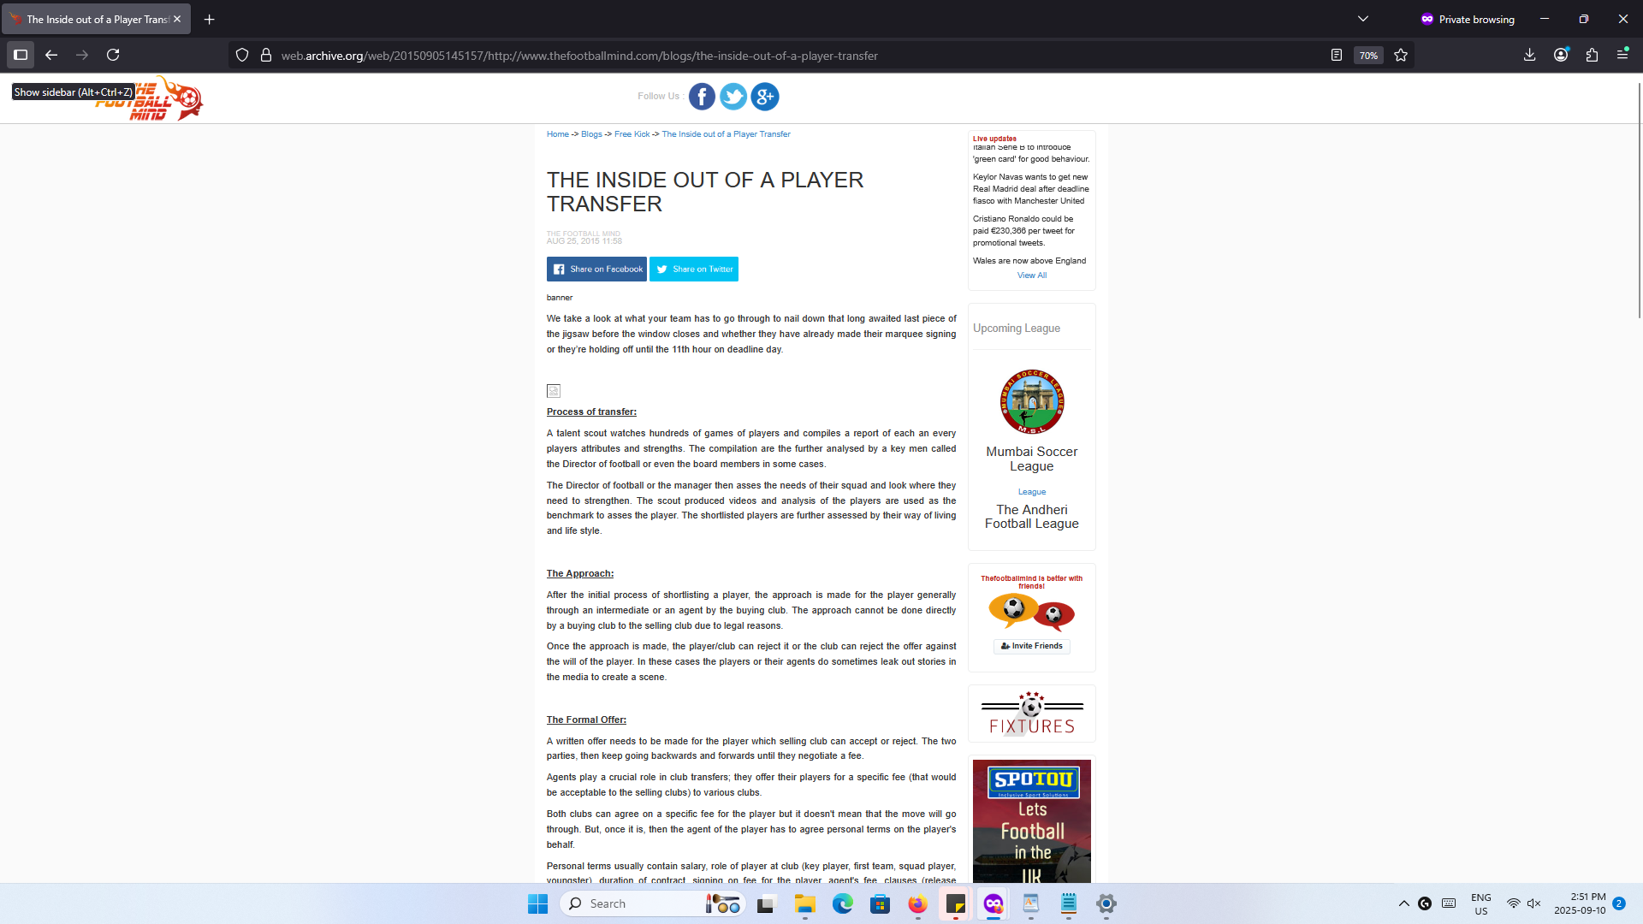
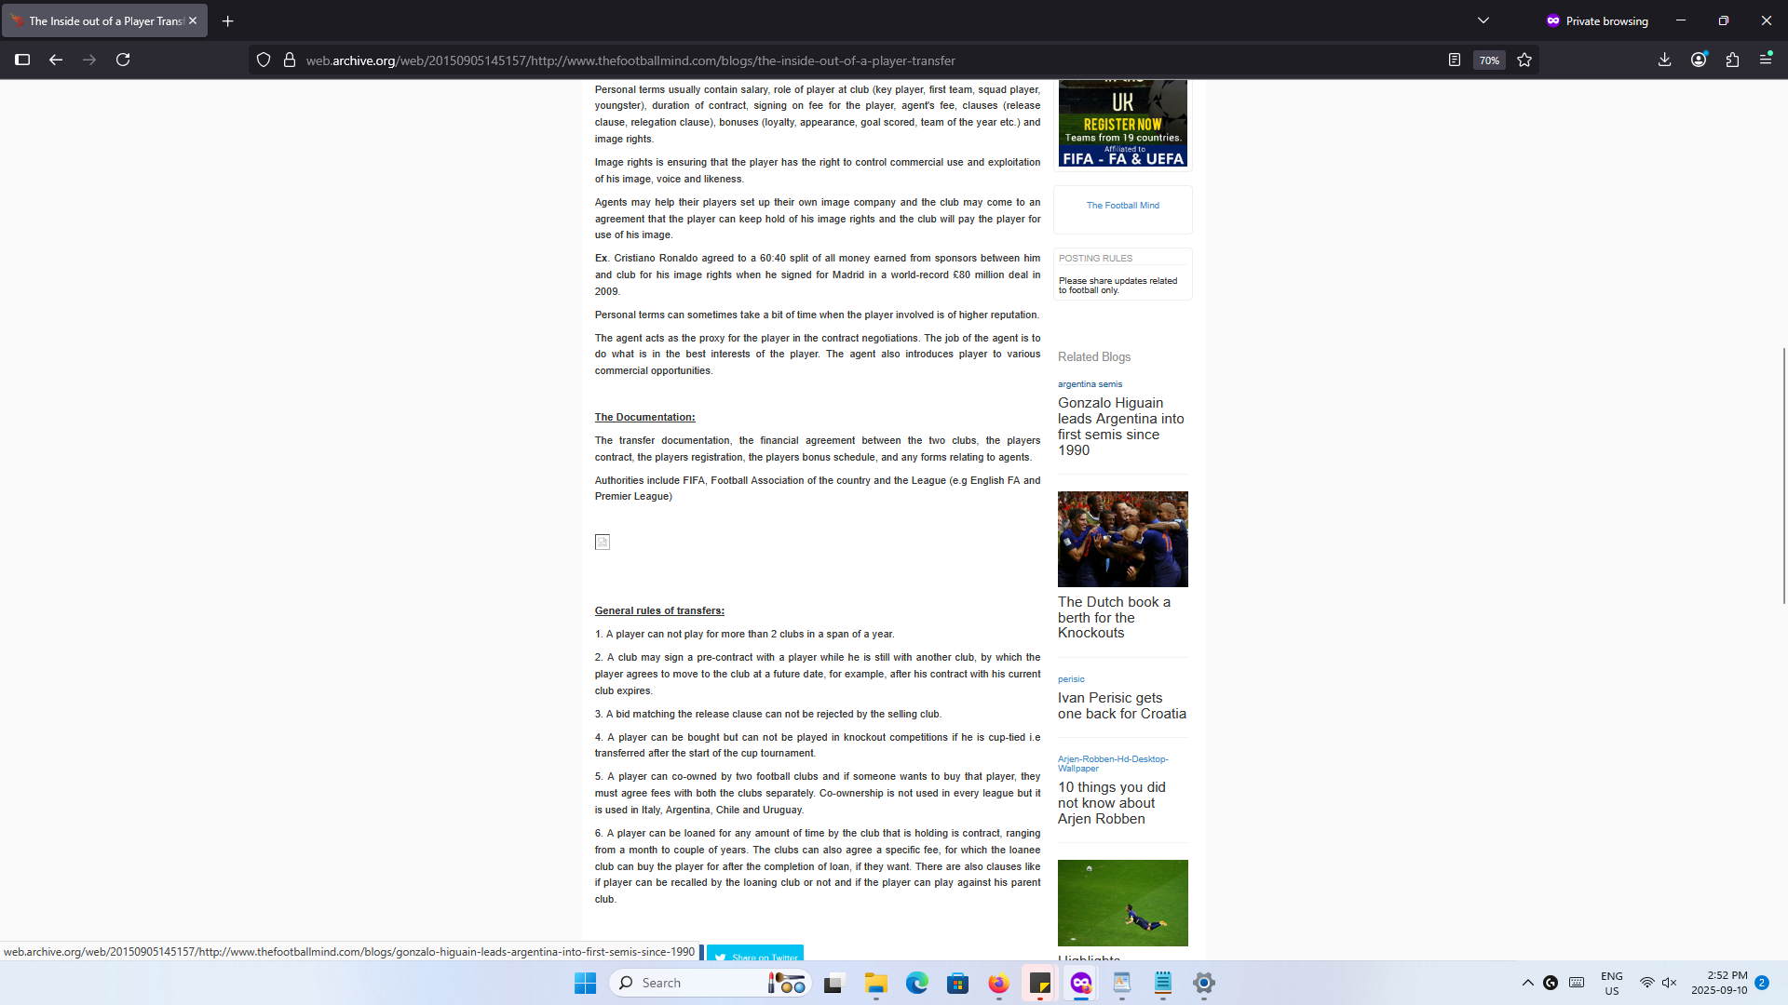
Article/Blog Sample
Wayback machine links: The website is now defunct but old articles had over 2k hits weekly from Facebook and Reddit. Here’s a link to one such article researched, copywritten, SEO optimized and then published by me which gained popularity: Link to old work

Slide 4
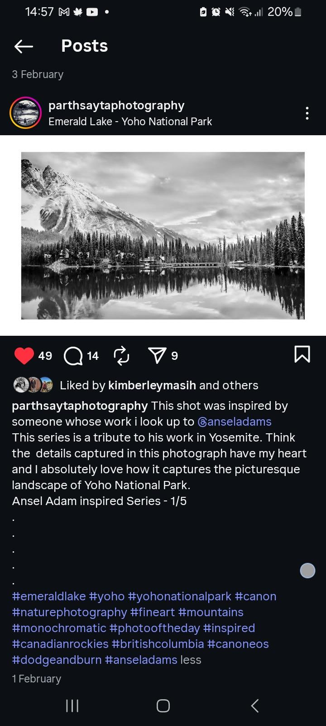
POST SAMPLE - Instagram
Tasked with posting, copywriting, digital marketing. [ over 5K organic engagement from campaign] Link to Clients Instagram
Caption: This shot was inspired by someone whose work i look up to @anseladams. This series is a tribute to his work in Yosemite. I Think the details captured in this photograph have my heart and I absolutely love how it captures the picturesque landscape of Yoho National Park. Ansel Adam inspired Series - 1/5 #emeraldlake #yoho #yohonationalpark #canon #naturephotography #fineart #mountains #monochromatic #photooftheday #inspired #canadianrockies #britishcolumbia #canoneos #dodgeandburn #anseladams

Slide 5
Email Marketing Sample - mobile and desktop views
Brand: Canadian Tire
Type: Transaction Copy
Mobile Optimized
Desktop Optimized

Slide 6
Email Marketing Samples - 2
Tim Hortons
Feedback Survey
Mobile Optimized
Desktop Optimized
Arturia
Product Showcase
Mobile Optimized
Desktop Optimized

Slide 7
Email Marketing Samples - 3
CAMH
Newsletter
Mobile Optimized
Desktop Optimized

Slide 8
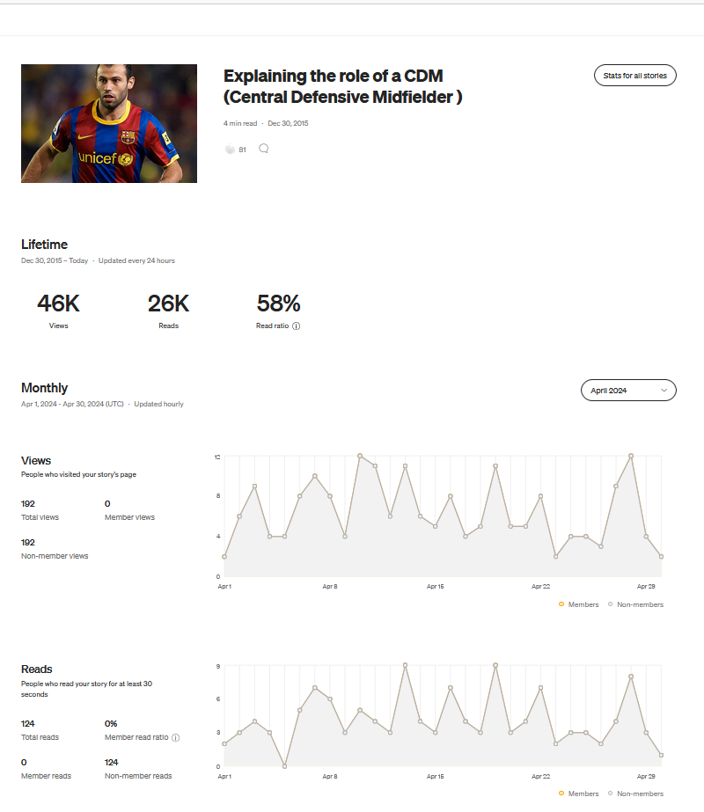
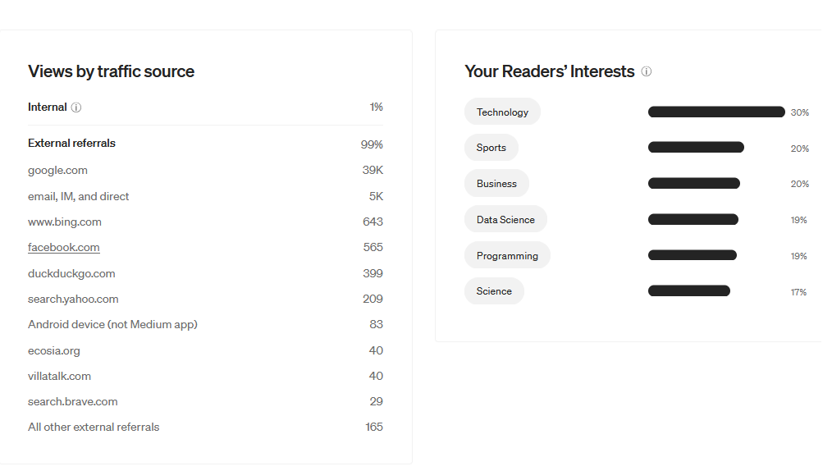
Article - Sample
Medium article
Published an article on defensive midfielders that has garnered over 46000 organic reads.

Slide 9
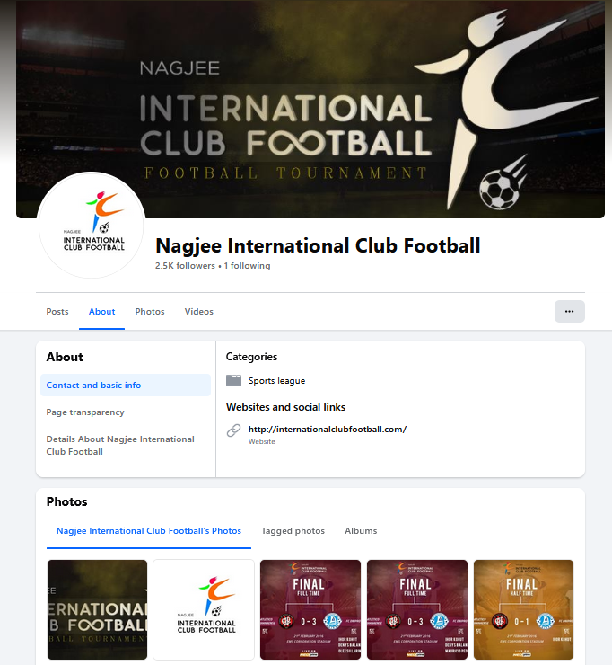
Live Event Coverage - Content, Social Media Samples
(2016)Sait Nagjee tournaments coverage from parent site thefootballmind.com.
Responsible for publishing accurate proof-read match reports within 10 minutes of the match ending
Also tasked with copywriting social media posts, the web content and press releases.
Page had over 25000 visitors daily during the tournament, all gained organically.
Leading sports networks utilized our data to generate news content since we were reporting from the ground.

Slide 10
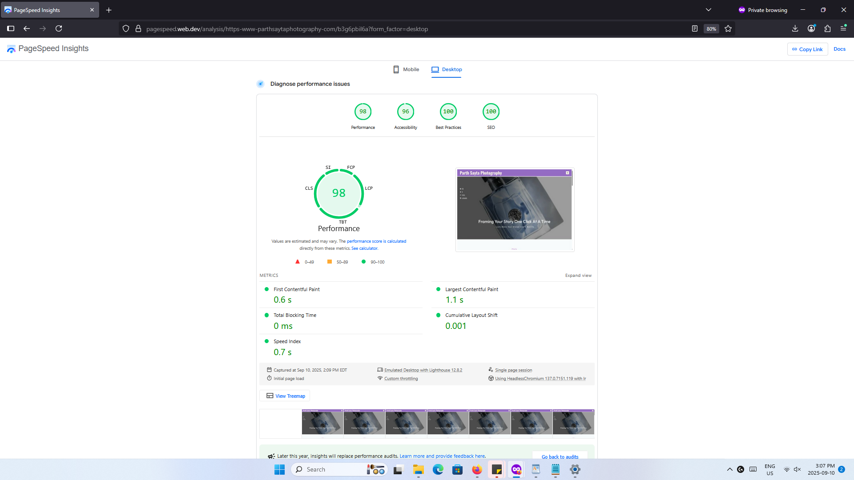
Case Study - Google Page Speed Insights
Developed a full-stack solution using:
Wordpress,
Gutenberg,
Akistmet,
Jetpack
Results:
It secured a score of 90+ on Desktop
And 99+ on Mobile on Google Page Insights.

Slide 11
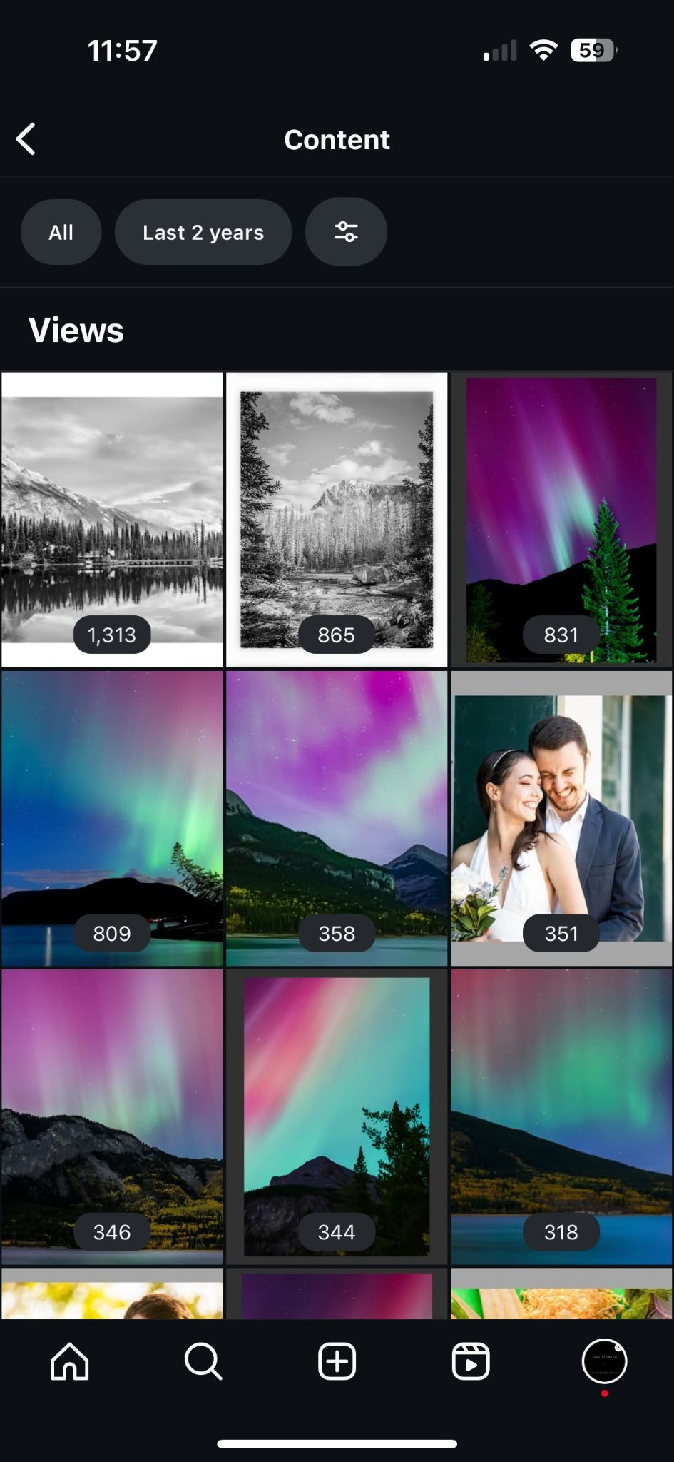
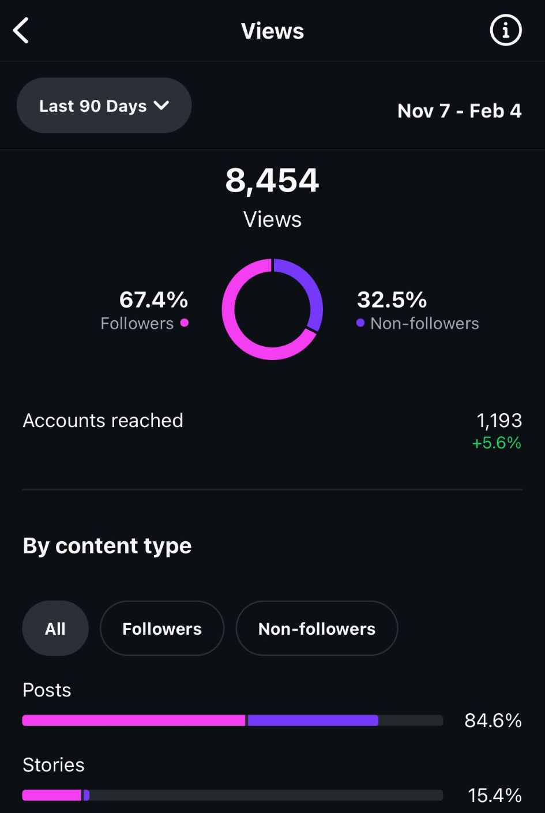
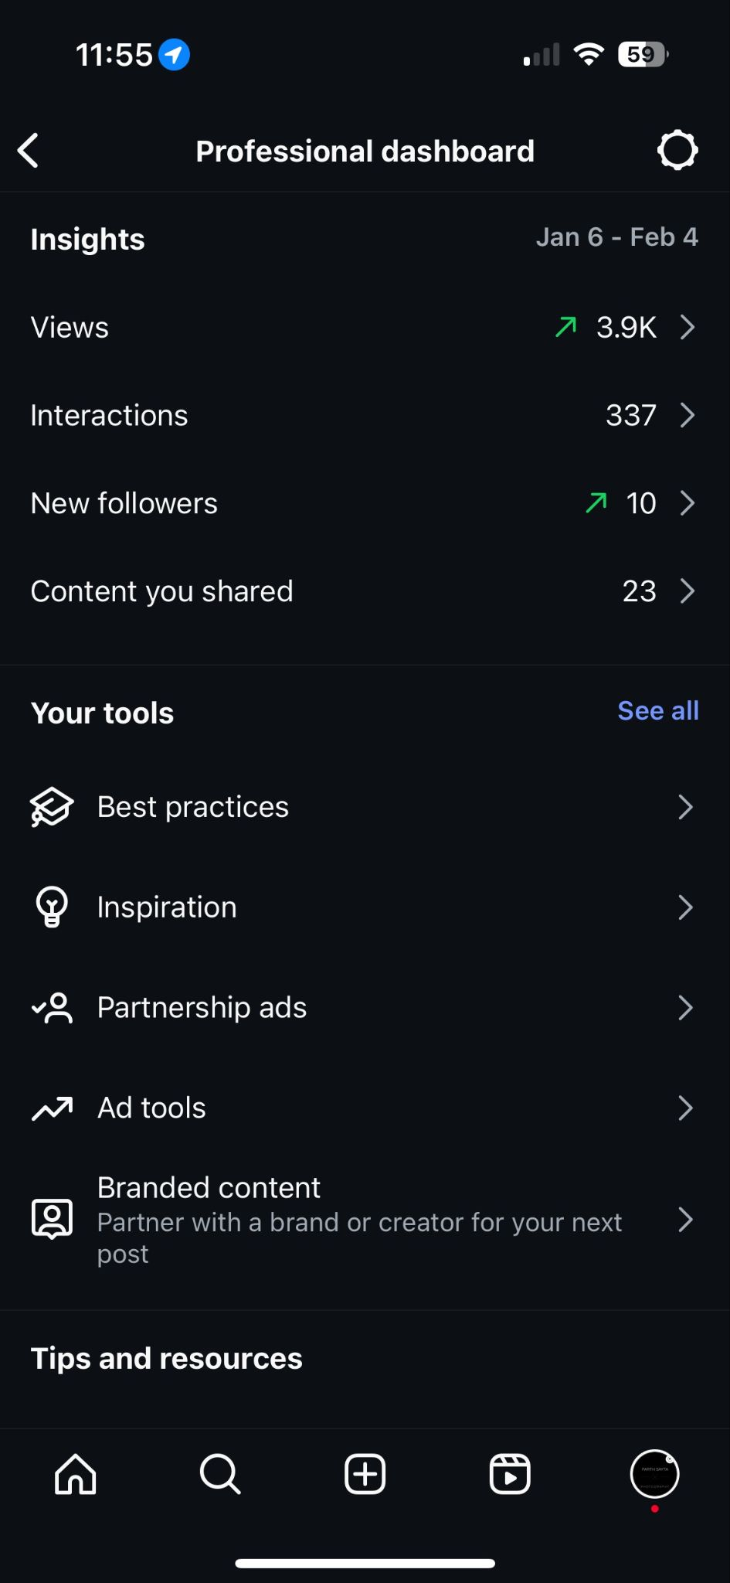
Case Study - Parth Sayta Social Media Results for 3 Campaigns
Beginning last quarter of 2024, Conducted a/b testing to get to 8400+ hits on Instagram and Facebook.
Reaching over 1000 accounts per week regularly via posting and stories.
TOP 3 instagram Images garnering over 3000 views.
Max views in 1 week in 2025 is over 3900+.

Slide 12
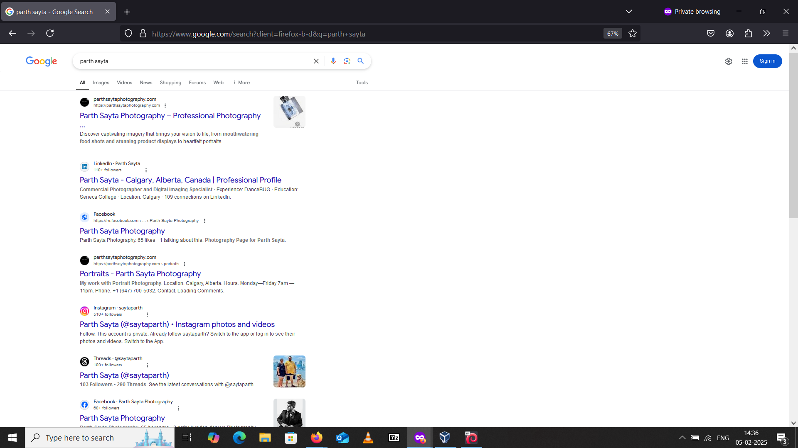
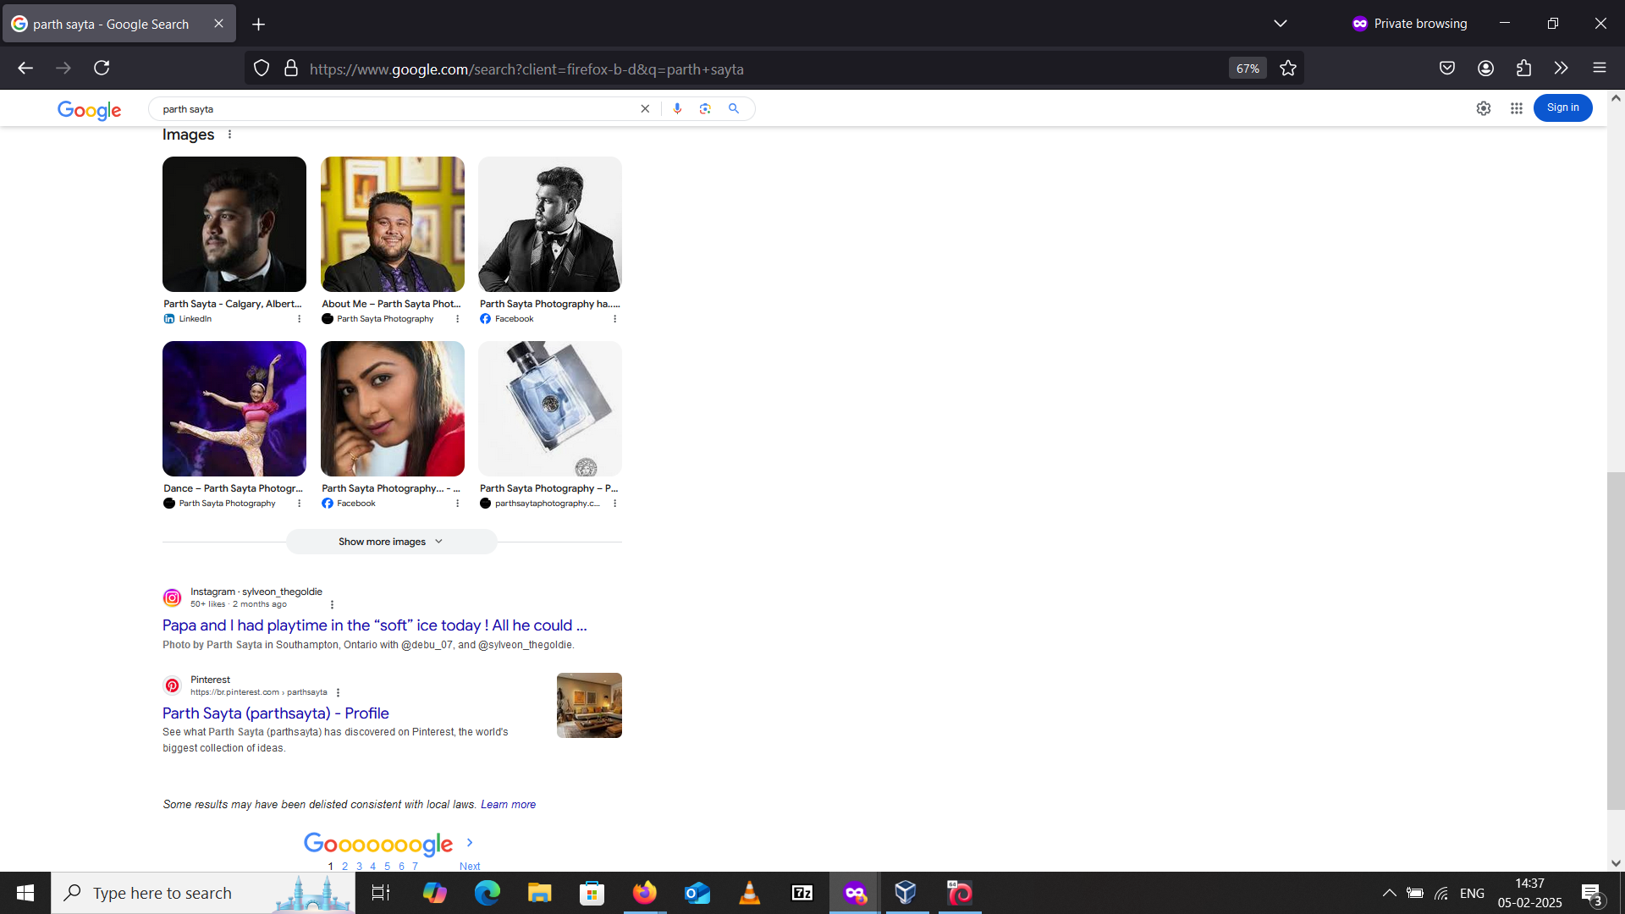
Case Study - Parth Sayta SEO Results- 1st page of google

Slide 13
Website Development Projects and Samples (Click on links to view)
Here is a website that is currently live:
1) Client Portfolio Website - Parth sayta Photography Website - Tech Stack: Wordpress, Gutenberg, Elementor, Akismet, Jetpack
Website Demonstrations - Non Live
1) E-Commerce Website – Screenshots – Tech Stack: Laravel, React with TypeScript, TailwindCSS, DaisyUI, FilamentPHP, Stripe payments.
2) Budget Tracker Plug-in (works as Microservice and Website both) – Screenshots – Tech Stack: React, Redux, Firebase.
3) E-Commerce Admin Dashboard – Code and Desktop Screenshots and Mobile Demo – Tech Stack: React, JavaScript, TailwindCSS, Framer Motion, Material UI.
4) Device Fingerprinting and Fake User Detection Module (Implemented on a wordpress site) – Video Demo – Tech Stack: Python, PHP, JavaScript, Shell Scripts.
5) My Portfolio – Tech Stack: TypeScript, Framer Motion, React, Next.js, Vercel, GitHub Pages, GitHub Actions – Hosted on GitHub and Vercel to test CI/CD.

